Slide 1
STEMI management
By
Saranya Temprasertrudee M.D.

Slide 2
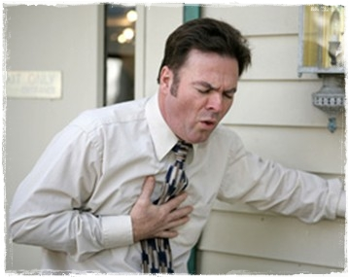


Slide 3
STEMI : Definition
new ST elevation at the J point in at least 2 contiguous leads of ≥2 mm (0.2 mV) in men or ≥1.5 mm (0.15 mV) in women in leads V2–V3
≥1 mm (0.1 mV) in other contiguous chest leads or the limb leads
Clinical syndrome
- characteristic symptoms of myocardial ischemia
- persistent electrocardiographic (ECG) ST elevation or new LBBB
- biomarkers of myocardial necrosis
2013 ACCF/AHA STEMI Guideline

Slide 4
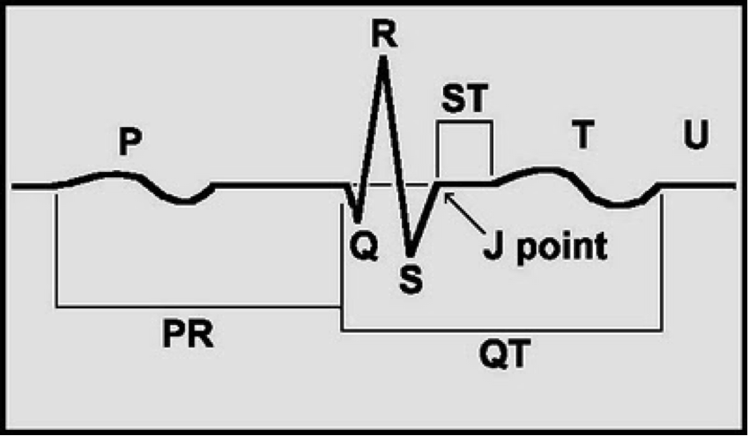

Slide 5
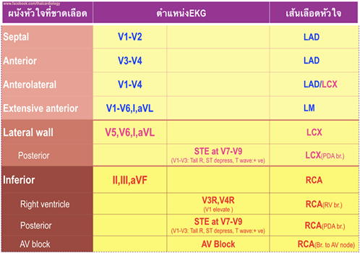

Slide 6
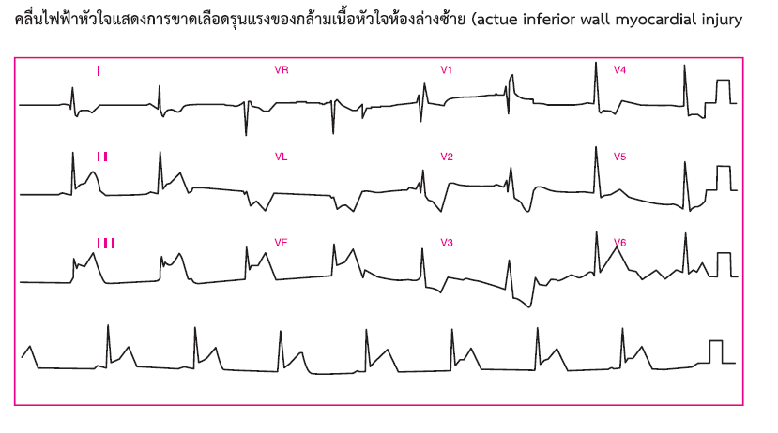
แนวทางเวชปฏิบัติในการดูแลผู้ป่วยโรคหัวใจขาดเลือดในประเทศไทย ฉบับปรับปรุง ปี 2557
Notes:
STE at II,II, AVF with incomplete RBBB with inverted T at V1-V4
With complete HB

Slide 7
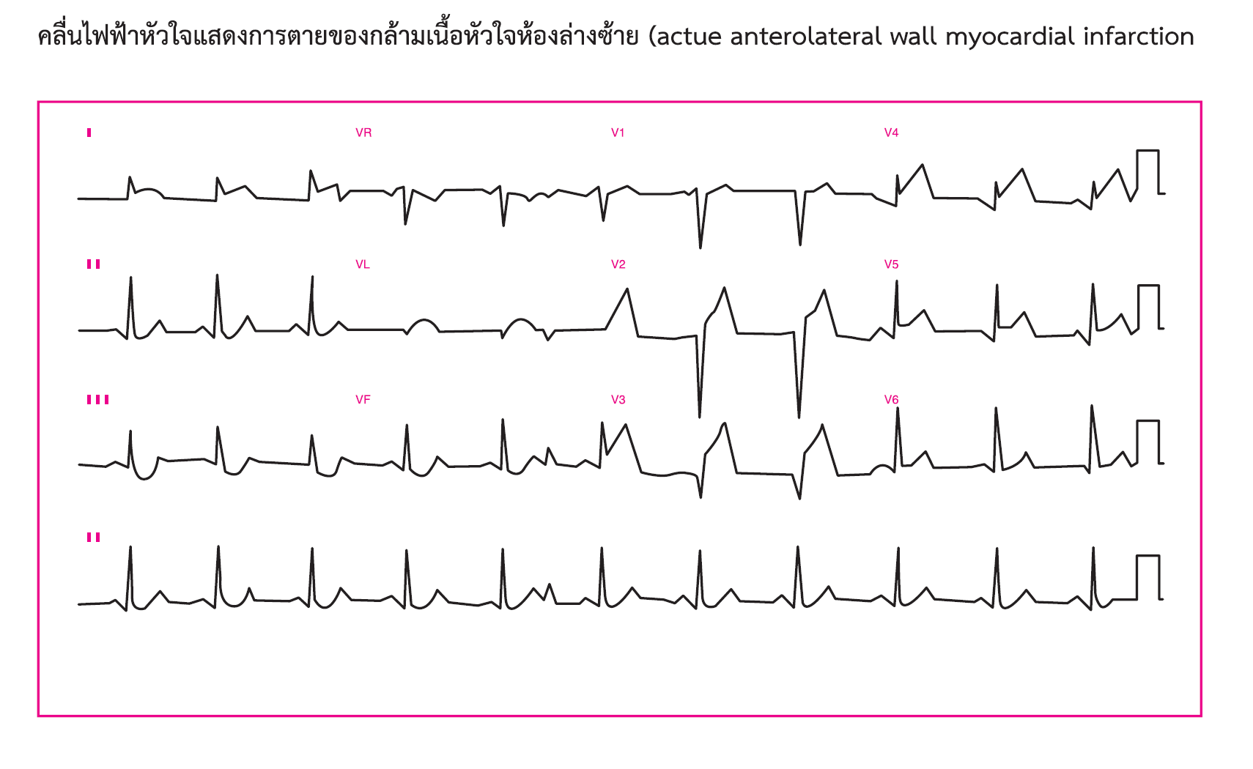
แนวทางเวชปฏิบัติในการดูแลผู้ป่วยโรคหัวใจขาดเลือดในประเทศไทย ฉบับปรับปรุง ปี 2557

Slide 8
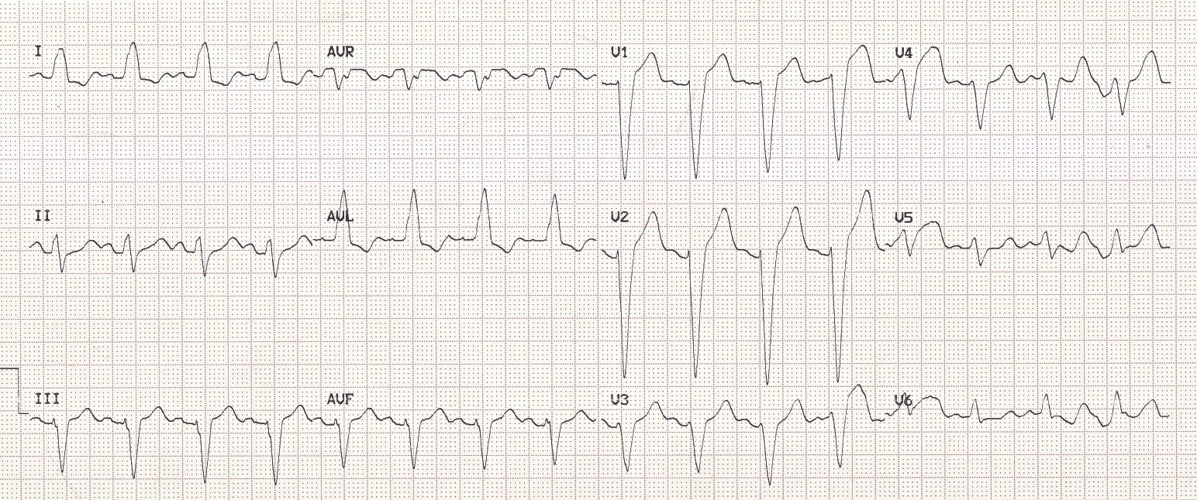
LBBB definition
QRS duration of > 120 ms
Dominant S wave in V1
Broad monophasic R wave in lateral leads (I, aVL, V5-V6)
Absence of Q waves in lateral leads (I, V5-V6; small Q waves are still allowed in aVL)
Prolonged R wave peak time > 60ms in left precordial leads (V5-6)

Slide 9
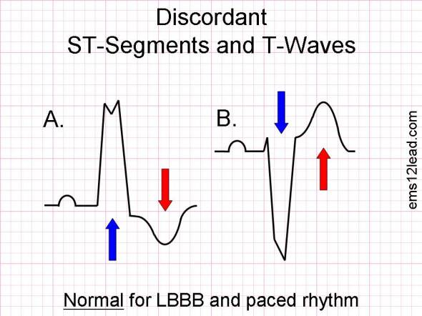
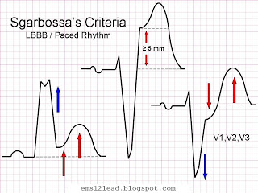
Sgarbossa Criteria
Concordant ST elevation > 1mm in leads with a positive QRS complex (score 5)
Concordant ST depression > 1 mm in V1-V3 (score 3)
Excessively discordant ST elevation > 5 mm in leads with a negative QRS complex (score 2)
These criteria are specific, but not sensitive for myocardial infarction
A total score of ≥ 3 is reported to have a specificity of 90% for diagnosing myocardial infarction

Slide 10
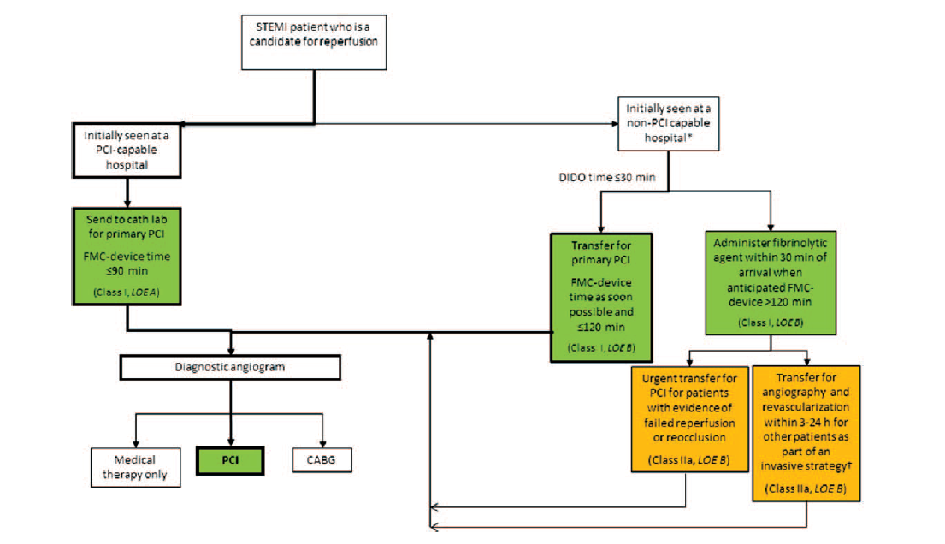
Rescue PCI
Pharmaco-invasive PCI
2013 ACCF/AHA STEMI Guideline
Notes:
DIDO = door in door outถ้าสามารถส่งออกภายใน 30นาที

Slide 11
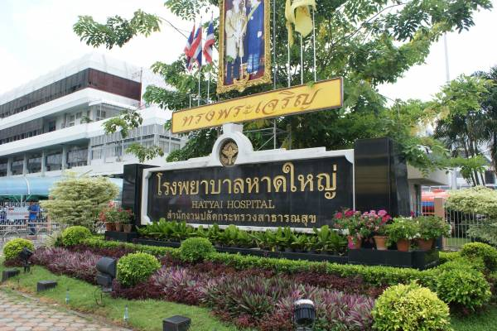
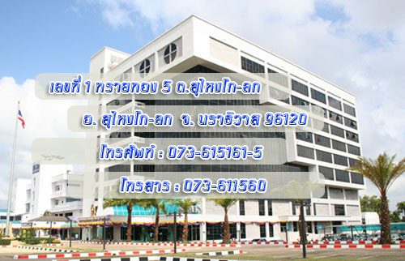
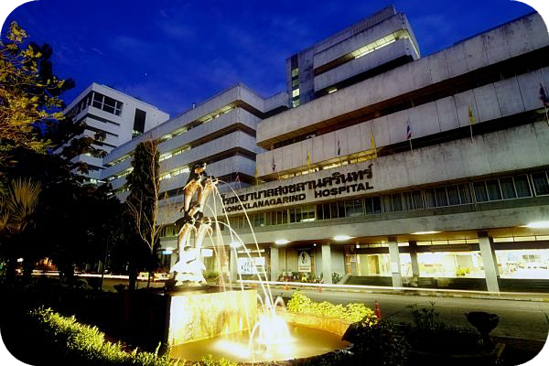
199 km
196 km

Slide 12
2013 ACCF/AHA STEMI Guideline

Slide 13
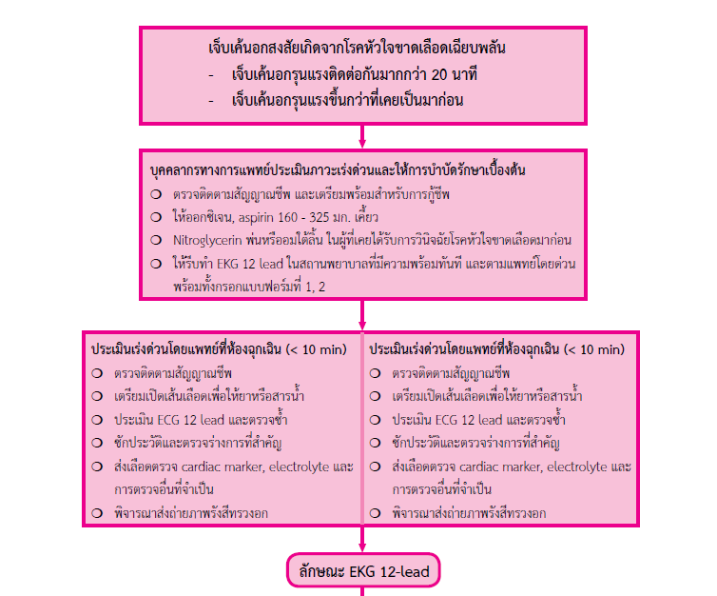

Slide 14
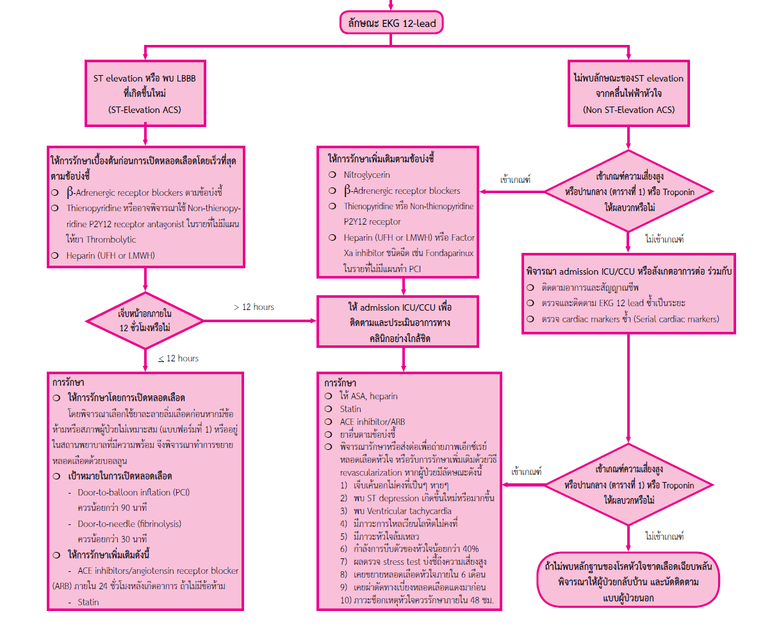

Slide 15
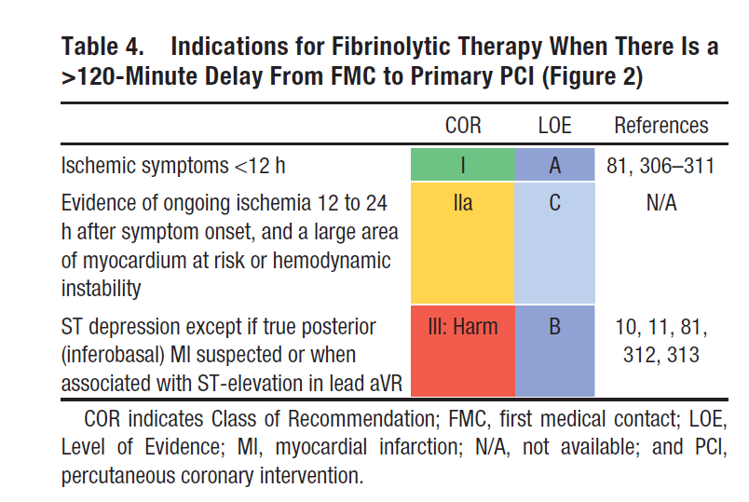
Timing of fibrinolytic therapy
2013 ACCF/AHA STEMI Guideline

Slide 16
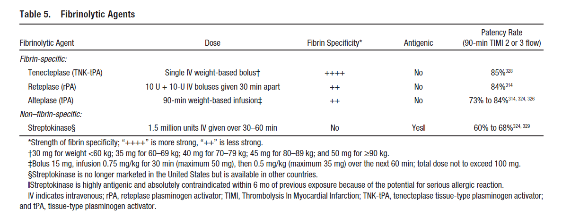
Fibrinolytic agents
2013 ACCF/AHA STEMI Guideline

Slide 17
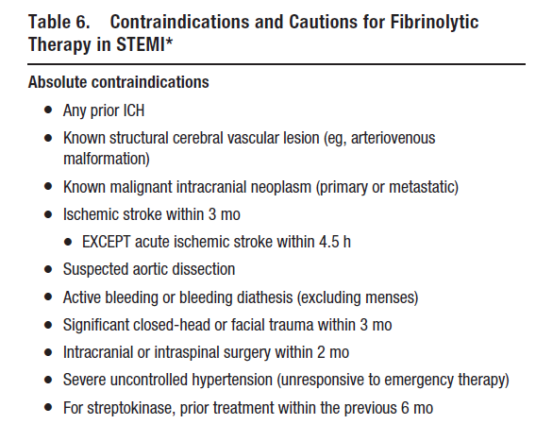
Contraindications for fibrinolytic therapy
2013 ACCF/AHA STEMI Guideline

Slide 18
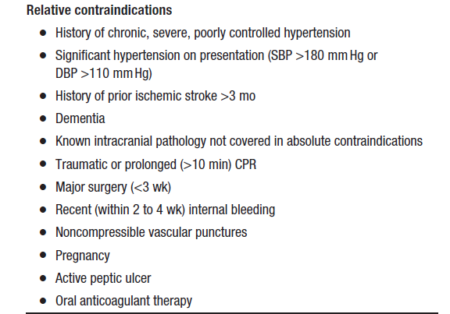
Relative contraindications for fibrinolytic therapy
2013 ACCF/AHA STEMI Guideline

Slide 19
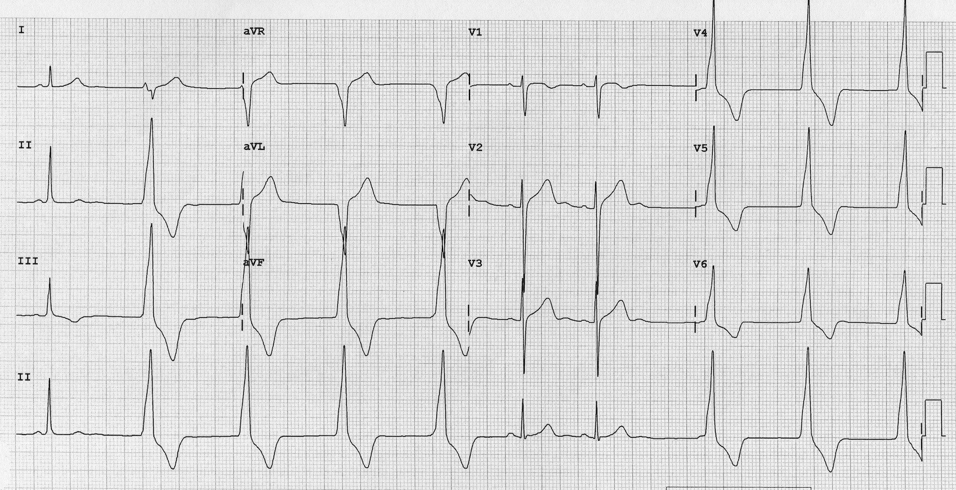
Assessment of reperfusion after fibrinolysis
Improvement in or relief of chest pain
Resolution of ST elevation > 50% in 60 or 90 minutes after fibrinolytic therapy
The presence of reperfusion arrhythmias (accelerated idioventricular rhythm, AIVR)
2013 ACCF/AHA STEMI Guideline

Slide 20
Common side effects of intravenous streptokinase
Abnormally Low Blood Pressure
Bleeding from Wound
Fever
Hemorrhage from the Gums

Slide 21
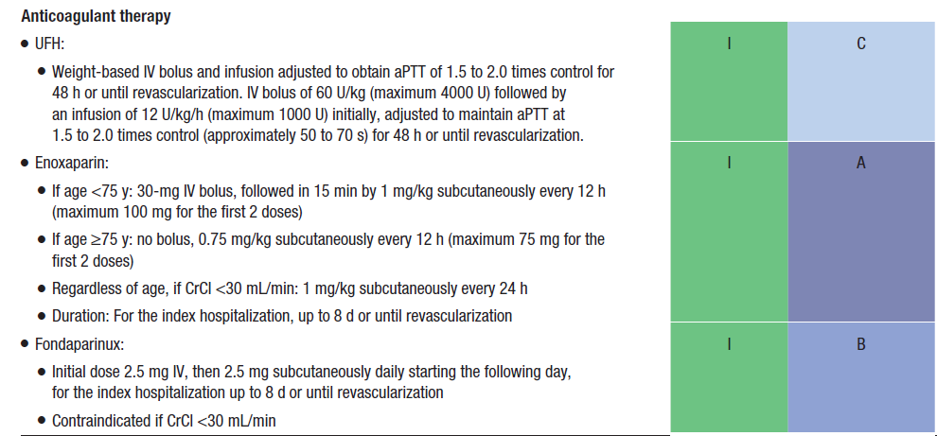
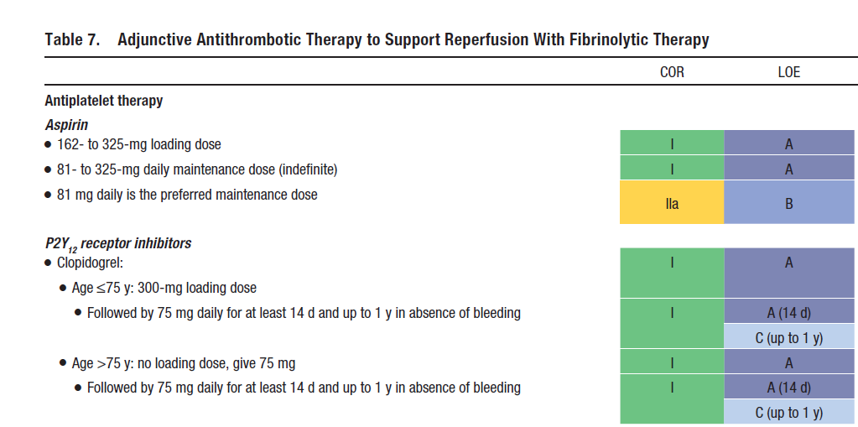
Adjunctive Antithrombotic Therapy to support Reperfusion With Fibrinolytic Therapy
Antiplatelet therapy
Anticoagulant therapy
2013 ACCF/AHA STEMI Guideline
Notes:
COR = class of recommendation, LOE = level of evidence
P2y12 inh.
Ticagrelor-> ใช้ได้ดีใน STEMI plan PCI หรือ NSTEMI
Prasugrel -> STEMI ที่รู้ anatomy

Slide 22
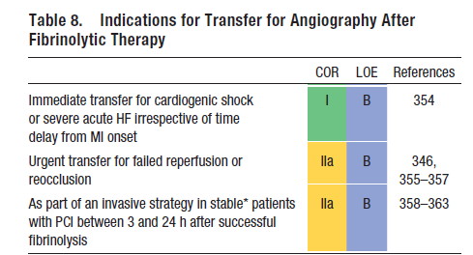
Indications for transfer for angiography after fibrinolytic therapy
2013 ACCF/AHA STEMI Guideline
Notes:
COR : class of recommendation, LOE : level of evidence
จาก Shock trial
Cardiogenic shock การให้ early revascularization after fibrinolytic = การทำ primary PCI ,benefit of emergency revascularization was apparent across a very wide time window, extending up to 54 hours after MI and 18 hours after shock onset

Slide 23
Routine medical therapies
Beta blockers
ACEI inhibitors/ ARB
Statin
Nitroglycerin
Oxygen
Morphine
2013 ACCF/AHA STEMI Guideline

Slide 24
Beta blockers
Contraindiations
signs of HF
evidence of a low output state
PR interval more than 0.24 seconds
second- or third-degree heart block
active asthma, or reactive airways
disease
Oral beta blockers should be initiated in the first 24 hours in patients with STEMI who do not have contraindications
Intravenous beta blockers in the patients with STEMI who are hypertensive or have ongoing ischemia
2013 ACCF/AHA STEMI Guideline

Slide 25
Renin-Angiotensin-Aldosterone System Inhibitors
ACE inhibitors should be administered within the first 24 hours to all patients with STEMI with anterior location, HF, or ejection fraction (EF) less<40%
ACE inhibitors are reasonable for all patients with STEMI and no contraindications to their use (B)
An angiotensin receptor blocker (ARB) should be given to patients with STEMI who have indications for but are intolerant of ACE inhibitors
2013 ACCF/AHA STEMI Guideline
Notes:
2,3 class IIa B

Slide 26
Renin-Angiotensin-Aldosterone System Inhibitors
An aldosterone antagonist should be given to patients with STEMI and no contraindications who are already receiving an ACE inhibitor and beta blocker and who have an EF ≤ 40% and either symptomatic HF or diabetes mellitus
2013 ACCF/AHA STEMI Guideline

Slide 27
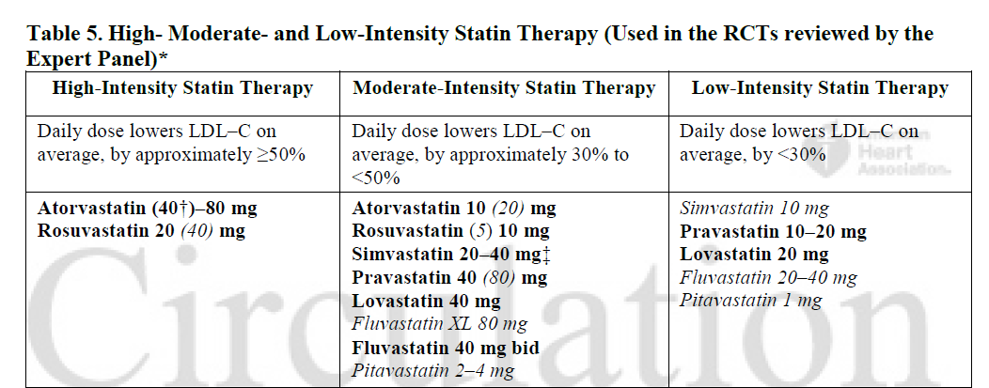
Lipid Management
High-intensity statin therapy should be initiated or continued in all patients with STEMI and no contraindications to its use
2013 ACCF/AHA STEMI Guideline
2013 ACC/AHA Blood Cholesterol Guideline

Slide 28
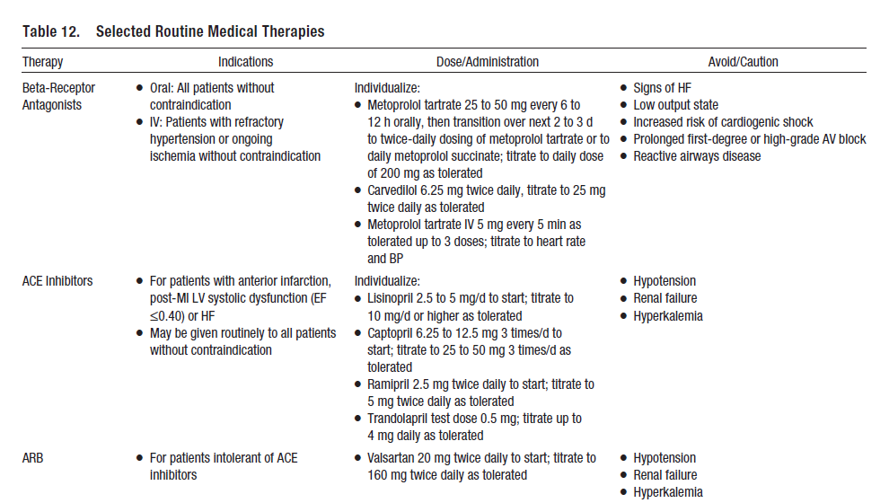
2013 ACCF/AHA STEMI Guideline

Slide 29
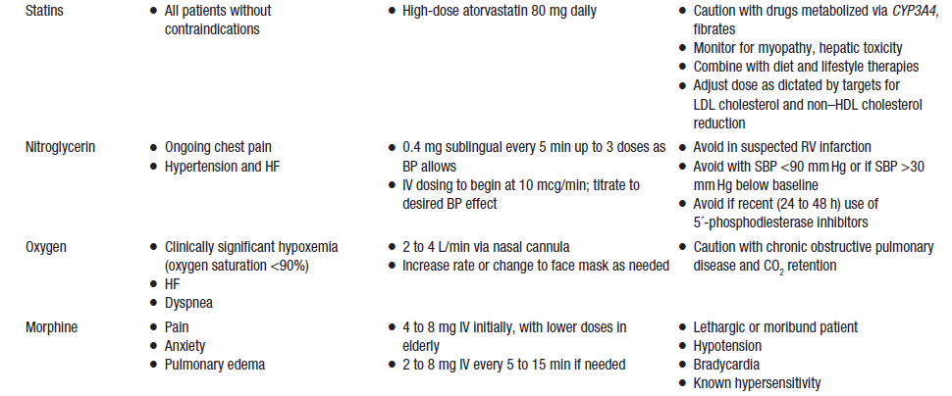
2013 ACCF/AHA STEMI Guideline

Slide 30
Complications After STEMI
Cardiogenic shock : early revasularization with either PCI or CABG
Severe HF : indication for angiography with intent to proceed with revascularization
RV infarction : inferior wall STEMI
2013 ACCF/AHA STEMI Guideline
Notes:
RV infarct clinical triad :hypotension, clear lung fields, and elevated jugular venous pressure
1-mm ST elevation in lead V1 and in right precordial lead V4R is the most sensitive ECG marker of RV injury

Slide 31
Complications After STEMI
Mechanical Complications : MR, Ventricular Septal Rupture, LV Free-Wall Rupture, LV Aneurysm
Electrical Complications
2013 ACCF/AHA STEMI Guideline

Slide 32
Long term therapy for STEMI
Stop smoking (50% decreased mortality)
- Buproprion and antidepressant, nicotine patches
Diet and weight control
- BMI < 25kg/m² ,Waist Circumferential>102 cm in male, 88 cm in woman
Management of comorbidities
Notes:
Management of comorbidities : Hypertension
● Diabetes
● HF
● Arrhythmia/arrhythmia risk

Slide 33
Long term therapy for STEMI
Physical activity (21% decreased vascular death)
-Exercise for a minimum of 30 minutes, preferably daily but at least 3 or 4 times per week (Level of Evidence: B)
- Cardiac rehabilitation/secondary prevention programs (Level of Evidence: C)
Notes:
-exercise (walking, jogging, cycling, or other aerobic activity), supplemented by an increase in daily lifestyle activities (eg, walking breaks at work, gardening, and household work) (Level of Evidence: B)
- Cardiac rehab :particularly those with multiple modifiable risk factors and/or those moderate- to high-risk patients in whom supervised exercise training is warranted (Level of Evidence: C)

Slide 34
Long term therapy for STEMI
Psychosocial factor intervention
- The psychosocial status of the patient should be evaluated, including inquiries regarding symptoms of depression, anxiety, or sleep disorders and the social support environment
- Treatment with cognitive-behavioral therapy and selective serotonin reuptake inhibitors can be useful for STEMI patients with depression that occurs in the year after hospital discharge

Slide 35
Long term therapy for STEMI
Resumption of activity
- Sexual activity can be resumed early if adjusted to physical ability
- Long distance air travel (4-6 weeks)

Slide 36

Thank you for your attention

