Slide 1
COPD and Asthma for you
^{นายแพทย์กรุณา ชวเลิศสกุล}

Slide 2
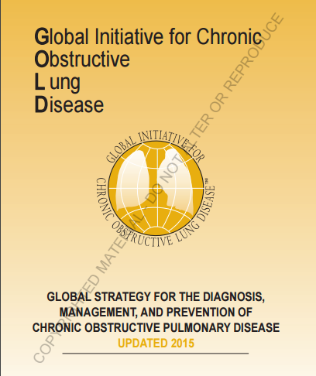
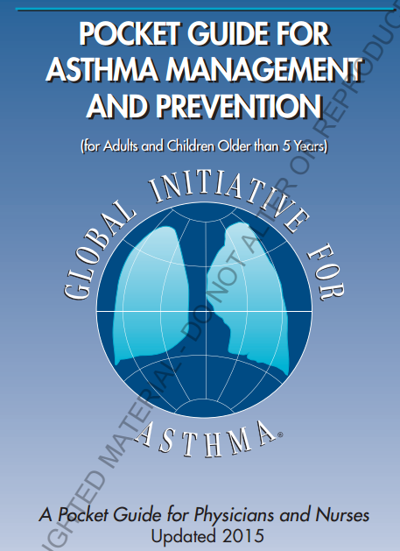

Slide 3
What is COPD
Chronic On Progressive Disease
Chronic On Progressive Dyspnea
Chronic Obstructive Pulmonary disease
Chronic Obstructive Pulmonary dyspnea

Slide 4
COPD definition
Preventable and treatable disease
Progressive not fully reversible airflow limitation
Noxious particle : Tobacco, in/out-door pollution, dust
Systemic inflammation : muscle, bone, etc.

Slide 5
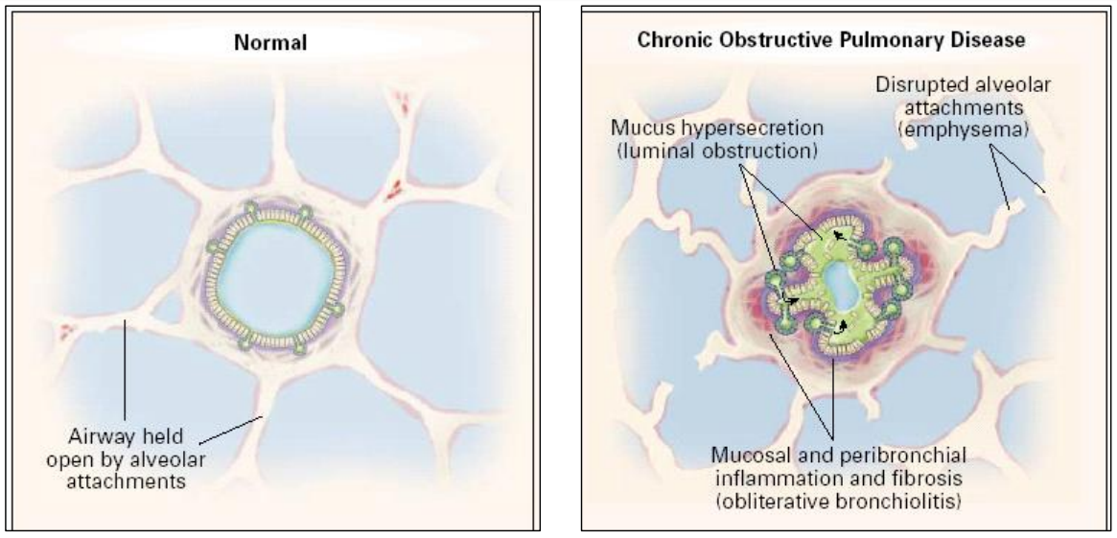

Slide 6
COPD diagnosis
Symptoms : dyspnea, cough, sputum
Exposure to the risk factors
Spirometry : post bronchodilator FEV1/FVC < 0.7
Exclude other diseases

Slide 7
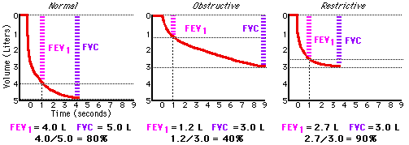
What is FEV1/FVC

Slide 8
COPD staging
Assess symptoms
Assess degree of obstruction
Assess exacerbation

Slide 9
Assess symptoms
CAT score
mMRC

Slide 10
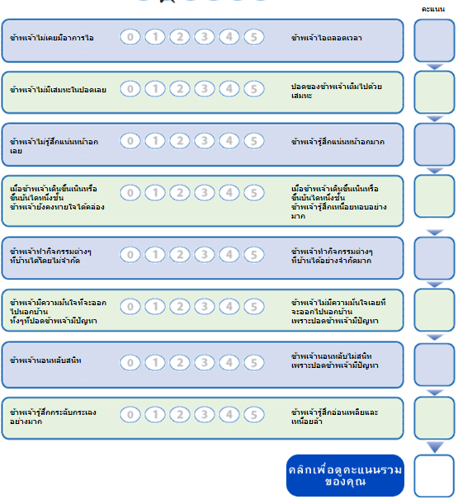
CAT score
Notes:
ไอ เสมหะ เจ็บหน้าอก DOE activity confident sleep alert

Slide 11
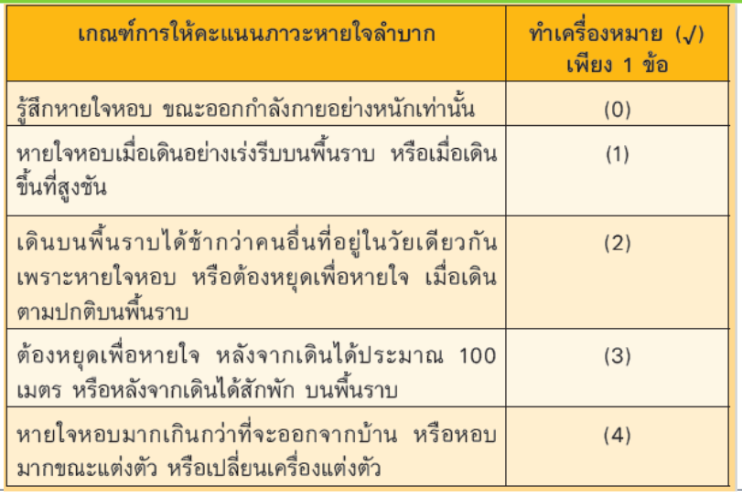
mMRC score

Slide 12
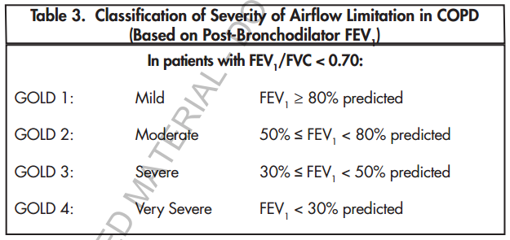
Assess degree of obstruction

Slide 13
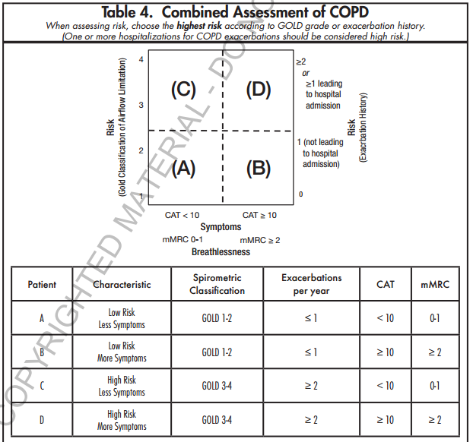

Slide 14
COPD Aim
Relieve symptoms
Exercise tolerance
Health status
Progression prevention
Exacerbation prevention
Decrease mortality
Reduce symptom
Reduce
risk

Slide 15
Treatment
Smoking cessation
  Counseling
  Nicotine replacement therapy
Smoking prevention
Avoid exposure
Physical activity

Slide 16
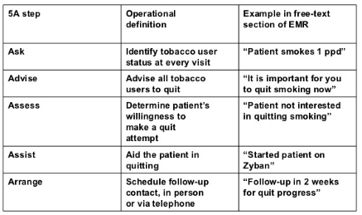

Slide 17
Treatment
Smoking cessation
  Counseling
  Nicotine replacement therapy
Smoking prevention
Avoid exposure
Physical activity

Slide 18
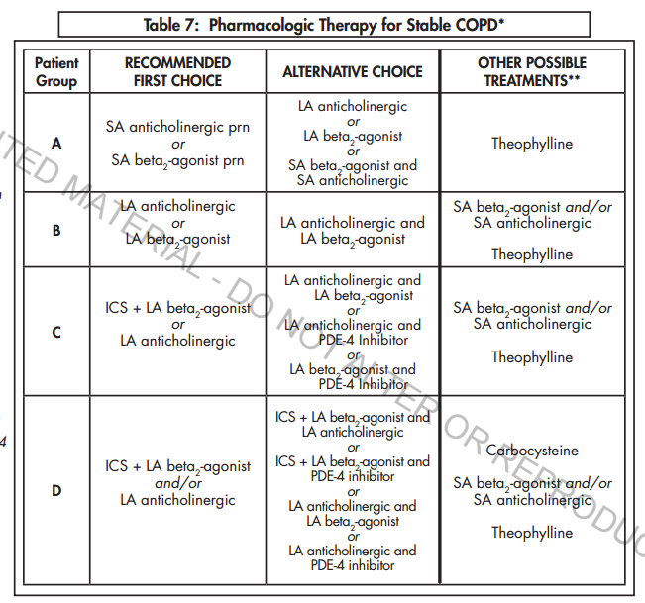

Slide 19
Bronchodilator
Short acting : for relieve acute symptom
Long acting : for control symptom
Prefer inhalation route
Synergist effect with SAMA

Slide 20
Corticosteroid
Good for control symptom
Avoid to use alone
Related with pneumonia
Avoid to use oral steroid too long

Slide 21
Methylxanthines
Add on therapy
Use only sustained-release form
Void to use alone

Slide 22
PDE-4 inhibitor
No bronchodilated effect
Use in chronic bronchitis group with exacerbate > 2 /yr
No use with theophylline

Slide 23
Other drugs
Mucolytics can use if indicated
Antibiotics only in case of infection, No routine use
Long term macrolide is controversy

Slide 24
Non-pharmacologic treatment
Pulmonary rehabilitation
Long-term oxygen therapy
Vaccination

Slide 25
Pulmonary rehabilitation
Patient selection
Patient setting
Program
  Patient education
  Exercise training
  Psychological and behavioral intervention
  Nutritional assessment
  Outcome assessment

Slide 27
A
B
?
C

Slide 28
Oxygen therapy
PaO2 < 55 mmHg or SpO2 < 88%
PaO2 < 60 mmHg or SpO2 < 90% with
  Polycythemia : Hct > 55%
  Pulmonary hypertension

Slide 29
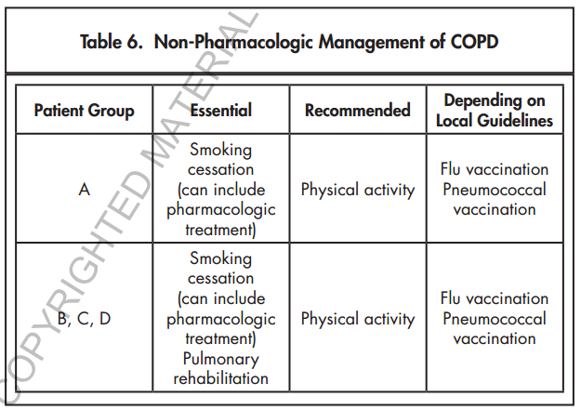

Slide 30
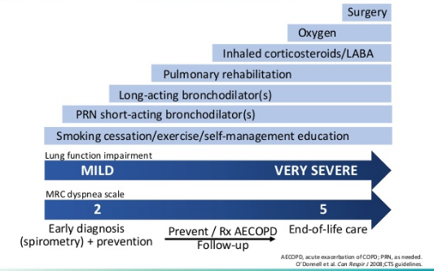

Slide 31
Exacerbation
Acute event that worsening respiratory symptoms than normal
  Dyspnea
  Cough
  Sputum
Leads to a change in medication
Most precipitate from resp. infection
No other condition

Slide 32
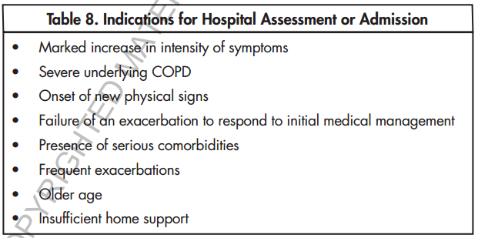
Admission

Slide 33
In-hospital care
Oxygen therapy to keep SpO2 88-92% (aware CO2 narcosis when over use oxygen)
Bronchodilator : MDI / Neb
Corticosteroid : IV / PO / Neb
Antibiotics only in infection

Slide 34
Respiratory support
Non-invasive ventilation(NIV) is prefer if no contraindication
NIV facilitates weaning
Evaluation clinical after 30-60 mins of NIV
ET-tube intubation if indicated

Slide 35
Contraindication of NIV
Invasive mechanical ventilation indication
Facial structure abnormality
Secretion obstruction
Hemodynamic instability

Slide 36
COPD and Comorbidities
Cardiovascular disease
Depression
Lung cancer
Infection
Structural lung disease
Metabolic syndrome
Etc.

Slide 37

To be continued…

Slide 38
What is asthma
ก. โรคหอบ
ข. โรคหืด
ค. โรคหอบหืด
ง. โรคหืดหอบ

Slide 39
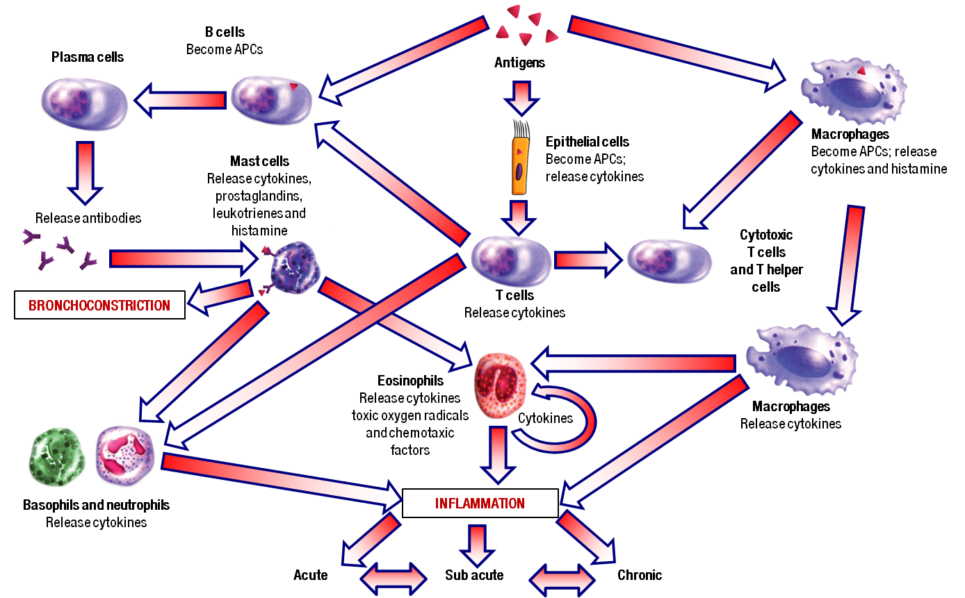

Slide 40
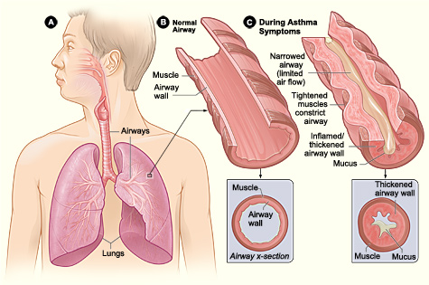

Slide 41
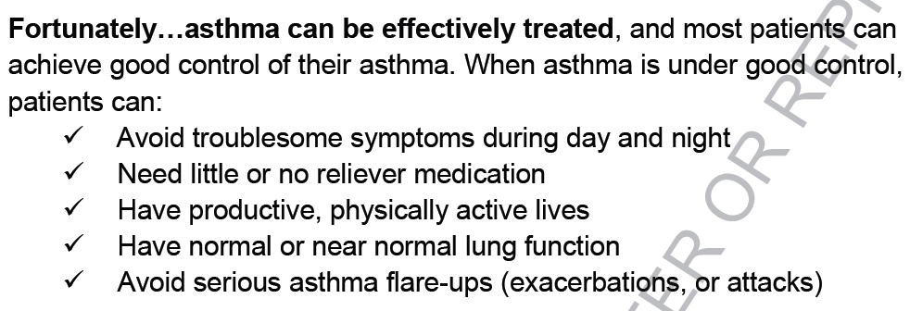

Slide 42
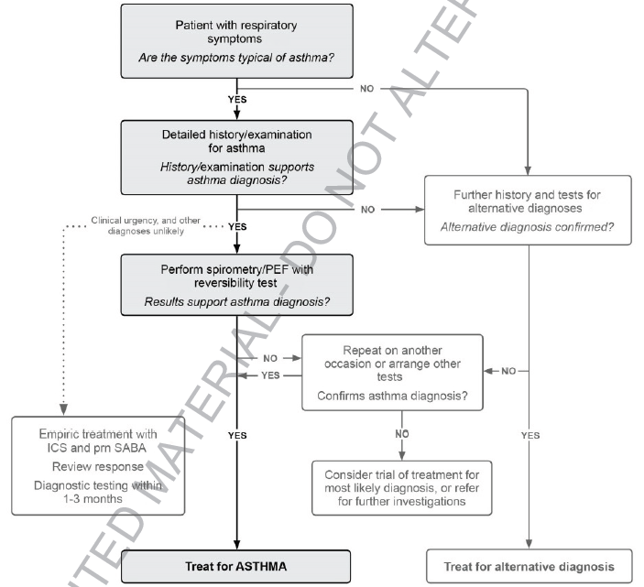

Slide 43
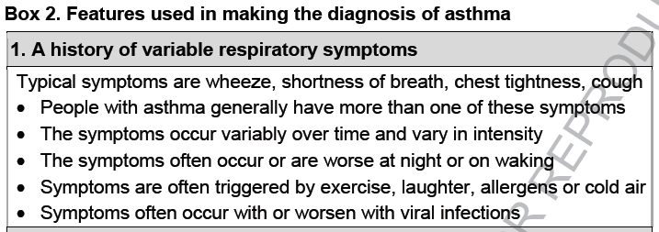

Slide 44
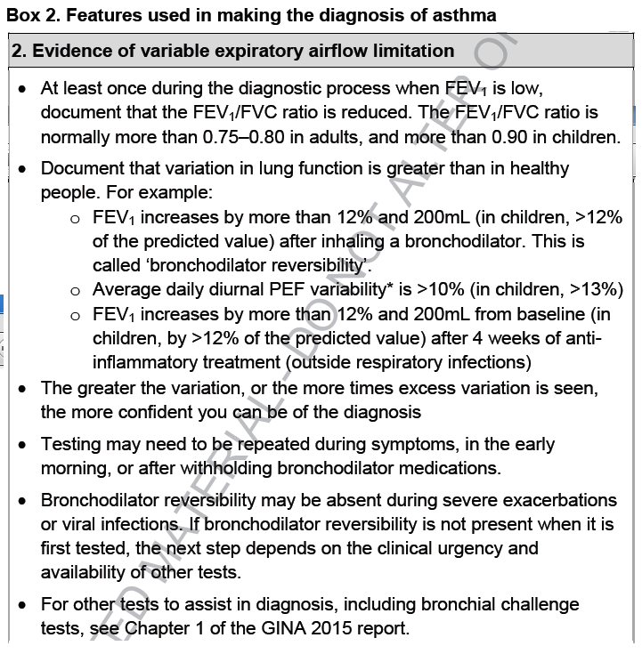

Slide 45
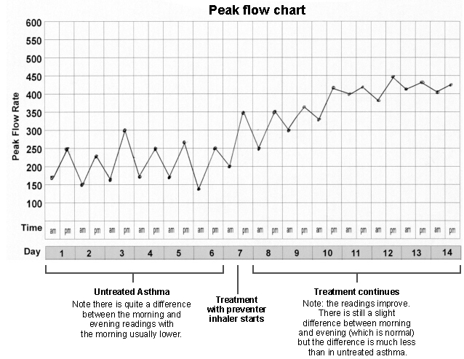

Slide 46
Other diagnostic test
Airway hyperesponsiveness test
  Methacholine test

Slide 47
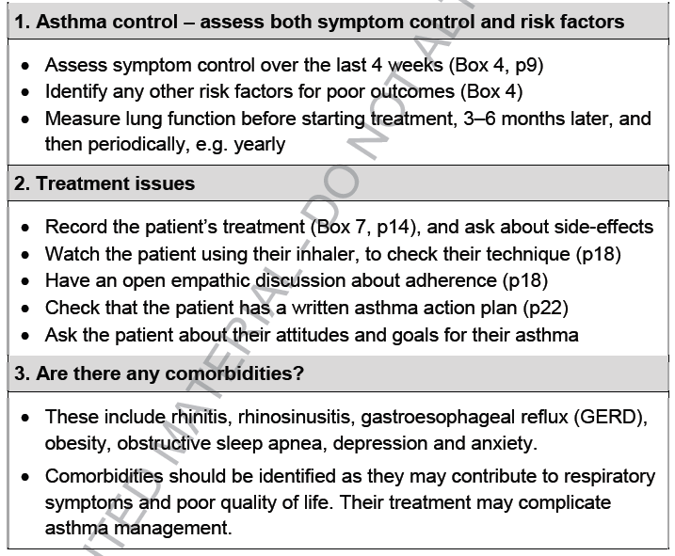
Asthma assessment

Slide 48
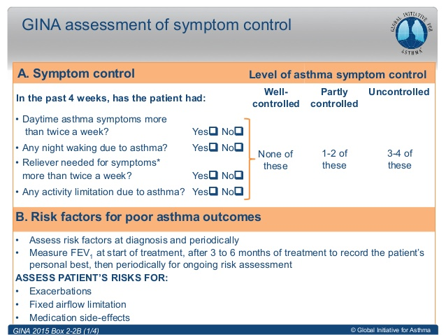
Symptom assessment

Slide 49
Risk factors of exacerbation
Uncontrolled symptom
Low FEV1 ( <60% )
Allergen exposure and smoking
Co-morbidity : psychiatry, AR, obesity, etc.
Pregnancy
History of exacerbation or admission
Sputum eosinophil

Slide 50
Risk of fixed A. obstruction
No inhale corticosteroid
Pollution or smoking
Poor pulmonary function
Eosinophilia

Slide 51
Risk of med. side effect
High dose of corticosteroid

Slide 52
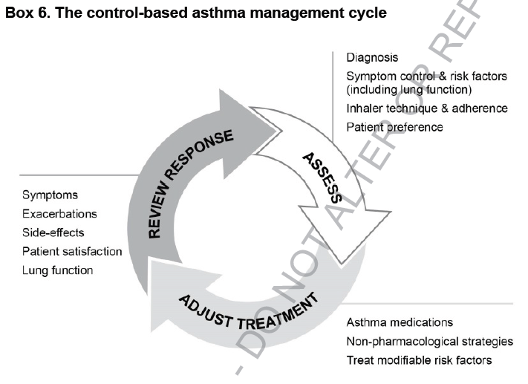

Slide 53
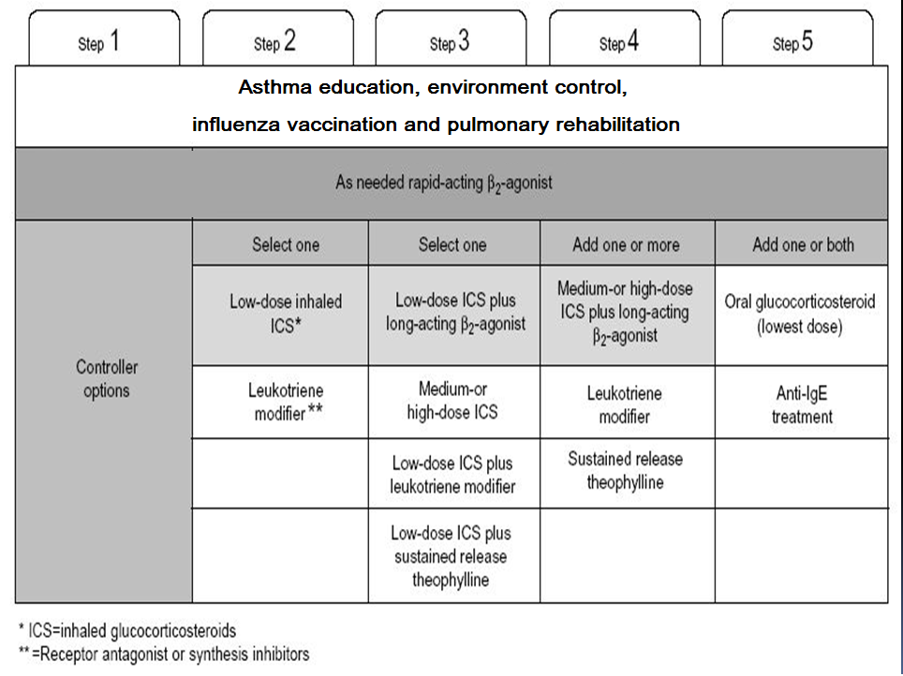

Slide 54
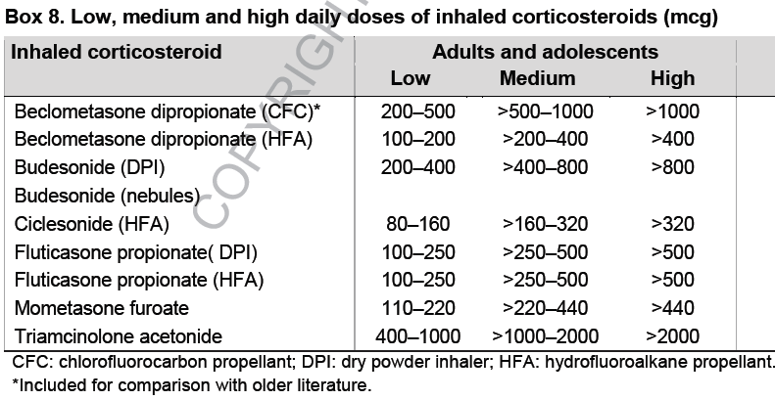

Slide 55
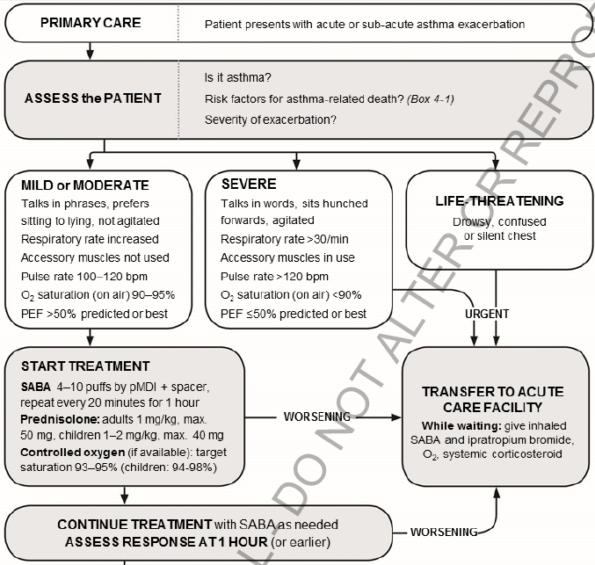
Exacerbation management

Slide 56
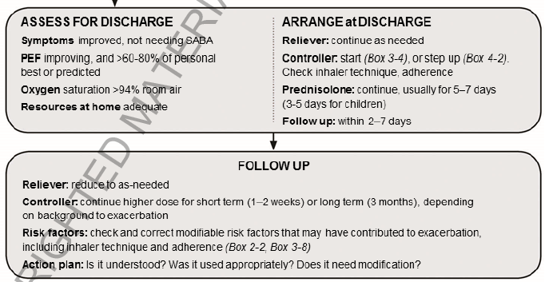

Slide 57


Slide 58
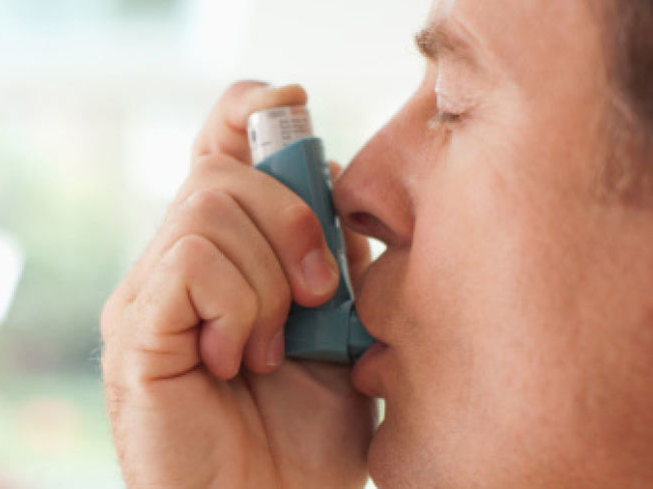
THE END

