Slide 1
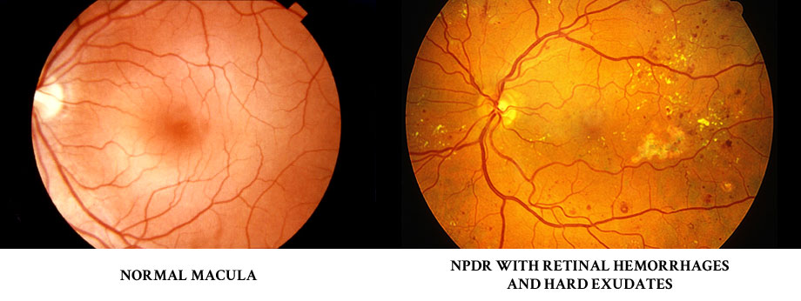
Diabetic Retinopathy
Sunpong jiamsawad MD.
Ophthalmology department
Sungai-kolok hospital

Slide 2
Outline
Terminology and classification
Epidemiology
Pathogenesis of DR
Background and diabetic macular edema
Treatment

Slide 3
Terminology and classification
DM : 2 hrs. glucose ≥ 200 mg/dl, fasting glucose ≥ 126 mg/dl, HbA1c ≥ 6.5%
Diabetes terminology
  IDDM : < 30 yrs
  NIDDM : > 30 yrs
  Specific type : GDM, secondary causes
Diabetic retinopathy terminology
  Nonproliferative diabetic retinopathy (NPDR)
  Proliferative diabetic retinopathy (PDR)
  DME : CSME

Slide 4
Epidemiology
WESDR
After 20 yr of DM
  99% of type I DM
  60% of type II DM
  3.6% of type I
  1.6% of type II
Some degree of retinopathy
Legally blind

Slide 5
Systemic factor
Age of onset (puberty : hormone, IGF)
Blood pressure control (WESDR, UKPDS)
Hyperlipidemia
Pregnancy
Genetic factors (HLA-DR3, HLA-DR4, HLA-A, HLA-B, HLA-C…)

Slide 6
Blood glucose control
DCCT (intensive group : mean HbA1c 7.5%)
UKPDS (intensive group : mean HbA1c 7.0%)
Tight blood sugar control
  Pros : decrease risk of DR development, DR progression and laser treatment
  Cons : increase hypoglycemia, hospitalization, possible death

Slide 7
Blood pressure control
WESDR
UKPDS
Tight blood pressure control
  Decrease DR progression
  Decrease laser treatment
  Decrease ME
  Decrease death related to DM and stroke

Slide 8
Lipid control
Observational evidence
Elevated lipids
  May increase the morbidity of macular edema
  Associate with hard exudates
  Contributes to the incidence and progression of both diabetic retinopathy and macular edema

Slide 9
Ocular factors
Reduce severity of DR
  Glaucoma
  Myopia
  RP
  Retinochoroidal scar
    Decrease retinal metabolism
Increase : advance carotid occlusive disease

Slide 10
Pathogenesis of DR
Capillary basement membrane thickening
Loss of microvascular intramural pericytes
Microaneuryms
Capillary acellularity
Breakdown of the blood-retinal barrier
Neovascularization

Slide 11
Normal
Thickened BM

Slide 12
Pathogenesis of DR
Capillary basement membrane thickening
Loss of microvascular intramural pericytes
Microaneuryms
Capillary acellularity
Breakdown of the blood-retinal barrier
Neovascularization

Slide 13
Normal pericyte nuclei
  Degularly spaced,
  Darkly staining bulges in the wall of the capillary
Pericyte dropout
  Empty
  Balloon-like spaces

Slide 14
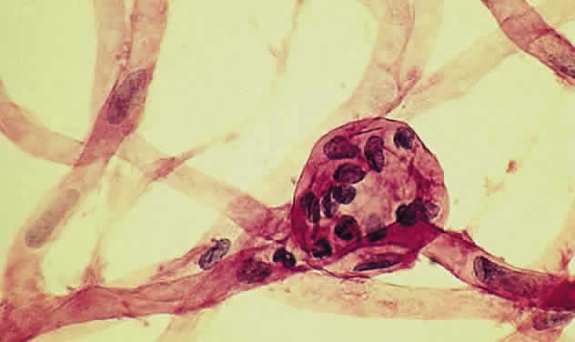
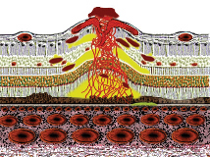
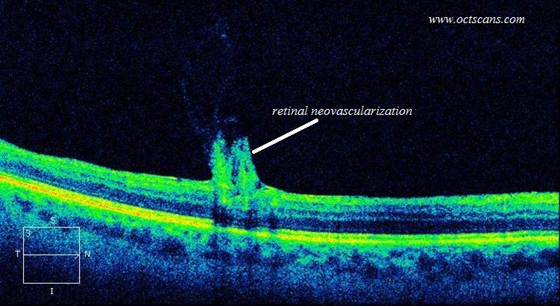
Pathogenesis of DR
Capillary basement membrane thickening
Loss of microvascular intramural pericytes
Microaneuryms
Capillary acellularity
Breakdown of the blood-retinal barrier
Neovascularization

Slide 15
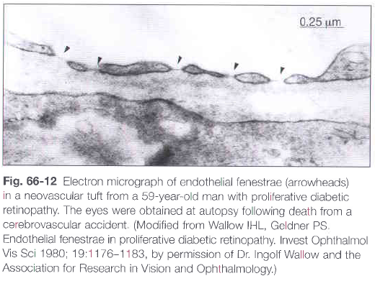
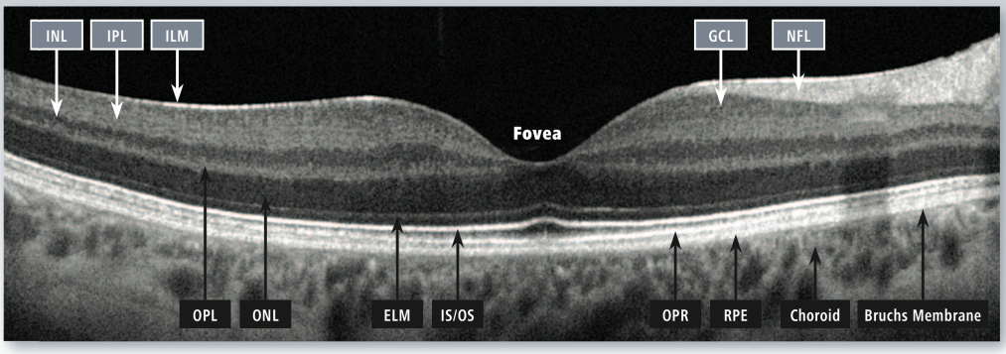
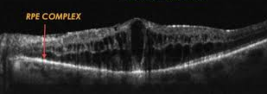

Slide 16
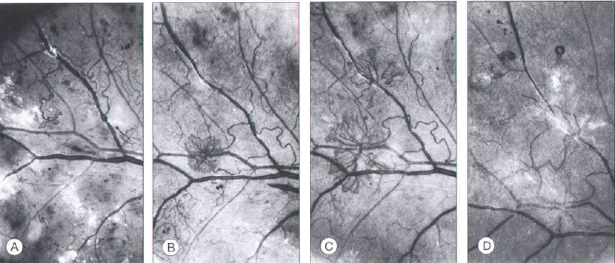
Proliferation and regression of new vessels
Barely visible NV → carriage wheel (irregular shape)
Superotemporal (more frequency) & Crossing both retinal arterioles and vein
Rate of growth are variable ( 1-2 wk to many months)
Proliferation of fibrous tissue accompanying new vessels

Slide 17
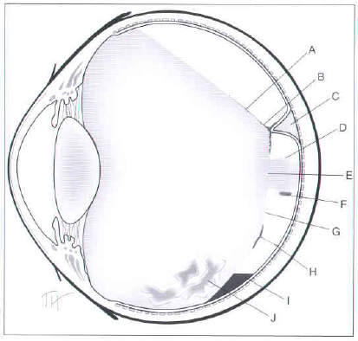
A-Posterioir surface of formed vitreous
B-Tight vitreoretinal adhesion
C-Localized SRF
D-Mushroom of formed vitreous
E-Hole in posterior vitreous surface
F-Blood in formed vitreous
G-Posterior vitreous surface
H-NV between retina & posterior vitreous
surface
I -Blood fluid level between retina
& posterior vitreous surface
J-Blood in formed vitreous
Contraction of the vitreous and fibrovascular proliferations
  Adhesion BTW NV & posterior vitreous (PVD, concave)
  Hemorrhage
Retinal distortion and detachment :
  Contraction of fibrovascular tissue → TRD, VH
Burned-out PDR :
  Completed PVD : regress new vv, decrease vv caliber, retinal ischemia

Slide 18
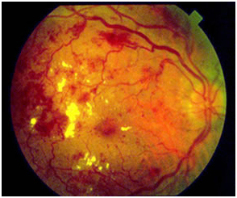
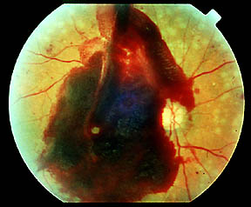
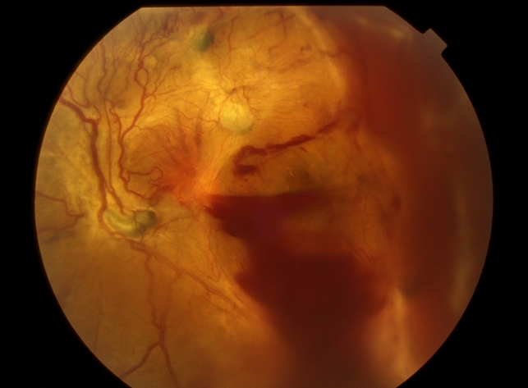
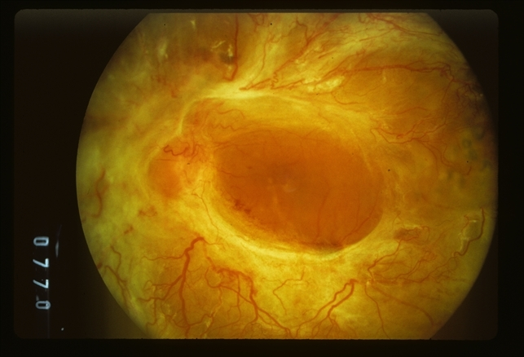

Slide 19
Pathology VS clinical findings
Pathology
Clinical findings
Loss of pericyte
Altered vascular
permeability
Closure of retinal vessels
Retinal ischemia
Fibroblast, glial contraction
Microaneurysm
Hard exudate, macular edema
Dot, blot hemorrhage, venous dilatation
Nonperfused area, CWS, NV
TRD, VH

Slide 20
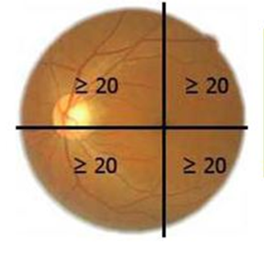
Classification of DR
Severity | Lesion present
No retinopathy | No retinal lesions
Mild NPDR | Microaneurysms only
Moderate NPDR | More than MA but less than severe NPDR
Severe NPDR “4-2-1 Rule” | Any of 1. ≥ 20 intraretinal Hg in each 4Q 2. Definite V. beading more than 2Q 3.Prominent IRMA more than 1Q
Very severe NPDR | 2/3 of severe NPDR

Slide 21
Classification of DR
Severity | Lesion present
PDR | New VV beyond ILM, fibrous proliferation, vitreous or pre-retinal Hg
Early PDR | New vessels (Definition not met for high-risk PDR)
High risk PDR | NVD 1/4 – 1/3 disc area or NVD and vitreous or preretinal Hg or NVE ≥ 1/2 disc area and vitreous or preretinal Hg
Mild Diabetic macular edema | Retinal thickening or HE in posterior pole, distant from center of fovea
Mod diabetic macular edema | Retinal thickening or HE approaching center of macular but not involving the center
Severe diabetic macular edema | Retinal thickening or HE involve center of macula

Slide 22
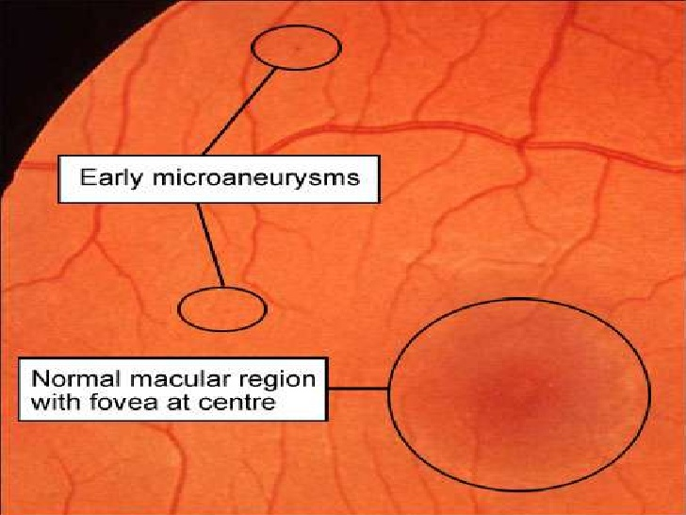
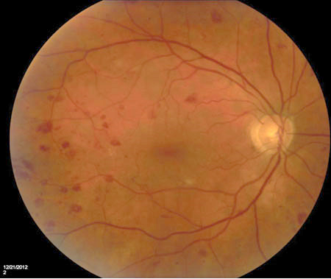
Microaneurysm vs Dot&Blot hg

Slide 23
Microaneurysm vs Dot&Blot hg

Slide 24
Hard exudate vs cotton wool spot

Slide 25
Venous beading

Slide 26
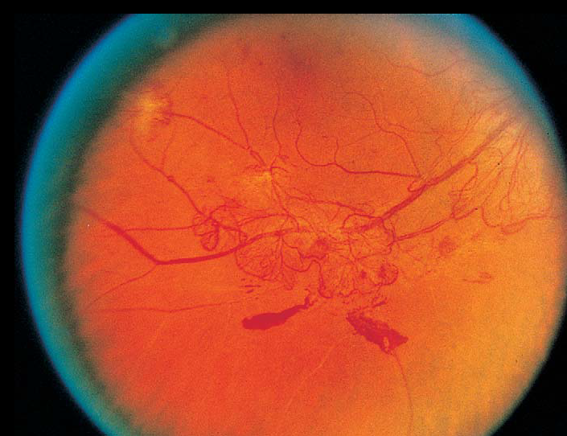
IRMA vs NV
IRMA
NV
Dilated preexisting VV
Not cross A&V
No fibrous proliferation
Intra-retina
May not leak from FFA
Wheel-liked network
Cross both A&V
Fibrous proliferation
Beyond retina
Always leak from FFA

Slide 27
IRMA vs NV
IRMA
NV

Slide 28
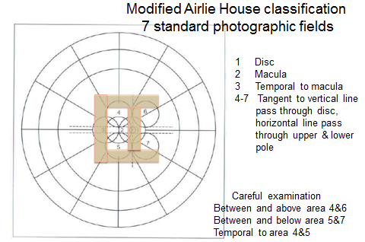
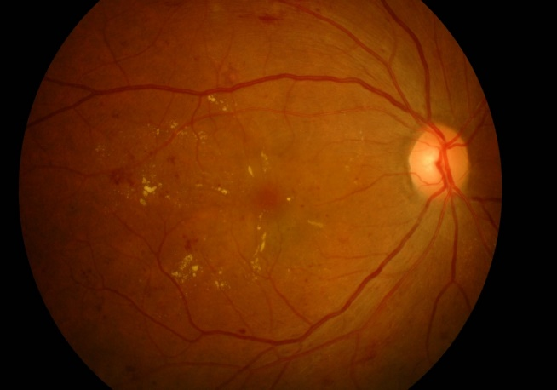
Exam :
  Posterior with in 45°of OD (NVD 15%, NVE 40%, both 45%)
  Scan: BTW & above 4-6, BTW & below 5-7, tempora 4-5

Slide 29
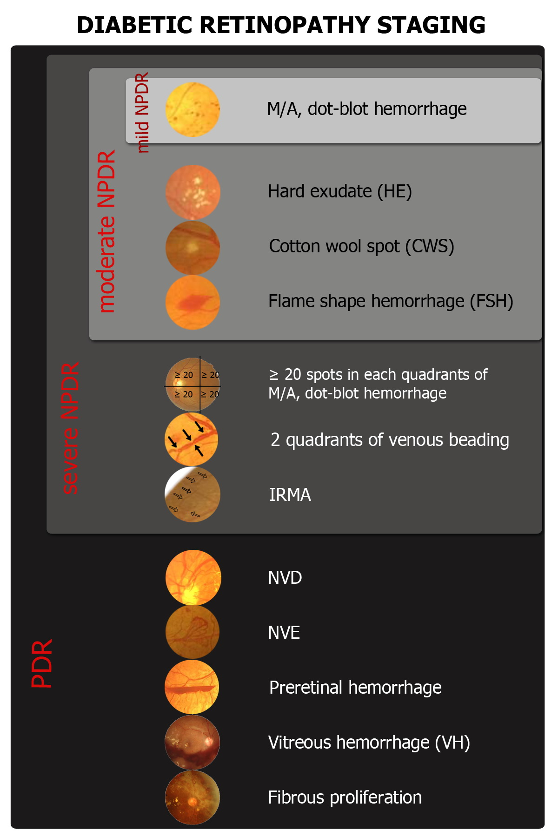
Diabetic retinopathy staging

Slide 30
Diabetic retinopathy staging

Slide 31
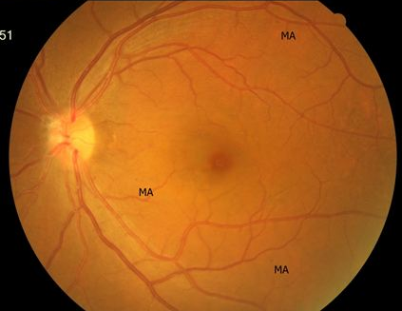
Mild NPDR : Microaneurysms only

Slide 32
Mod NPDR
H/Ma ≥ standard photograph No. 2A

Slide 33
Severe NPDR
Any of
  1. ≥ 20 intraretinal Hg in each 4Q
  2. Definite V. beading more than 2Q
  3.Prominent IRMA more than 1Q

Slide 34
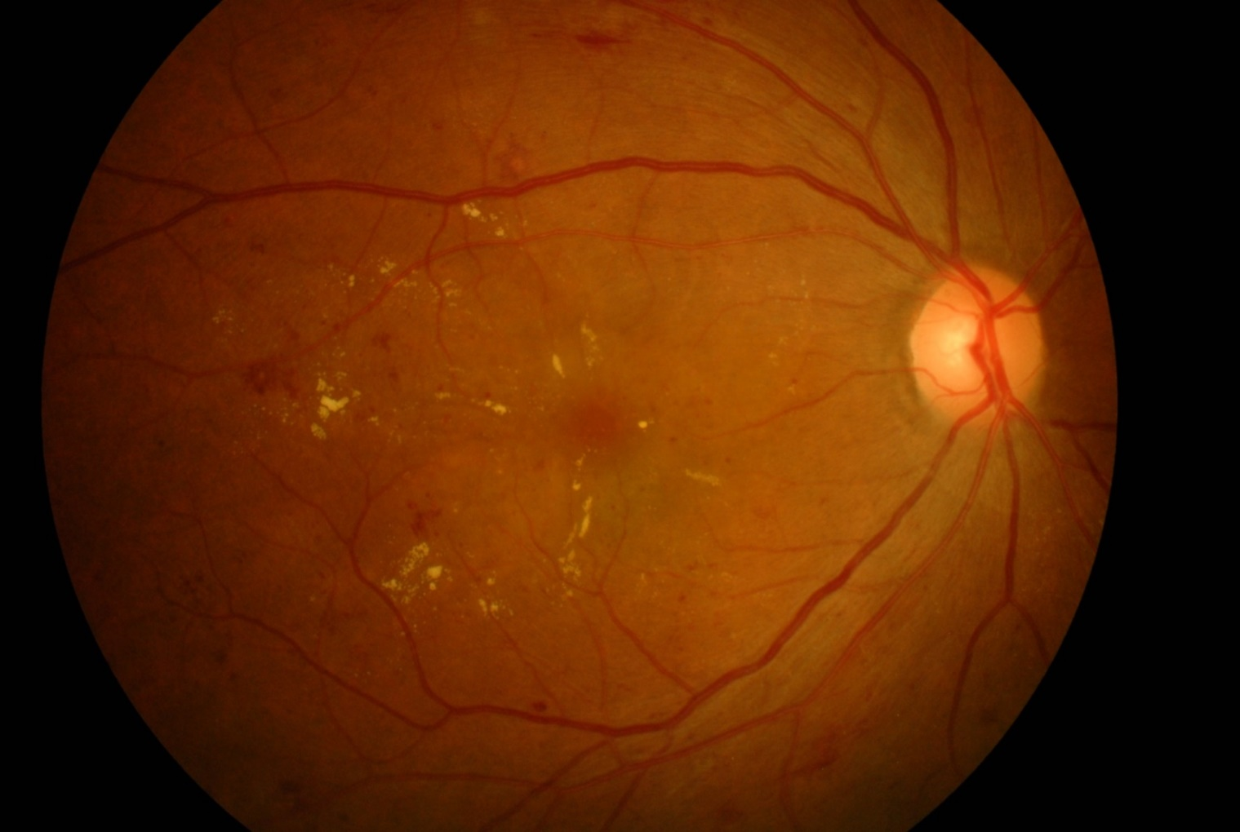
Very severe NPDR
2/3 of severe NPDR

Slide 35
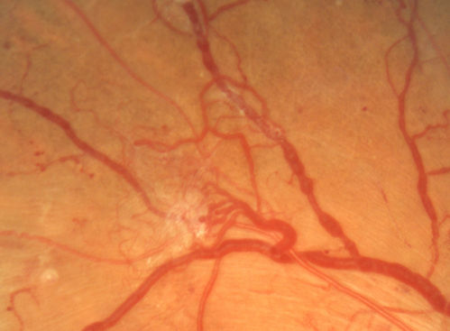
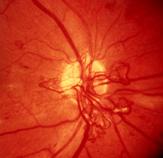
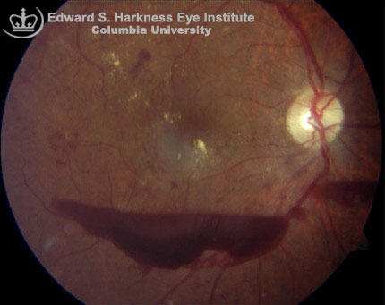
PDR
New VV beyond ILM, fibrous proliferation, vitreous or pre-retinal Hg

Slide 36
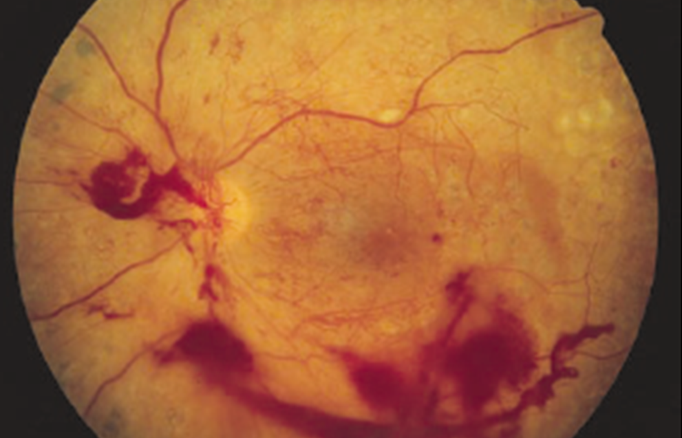
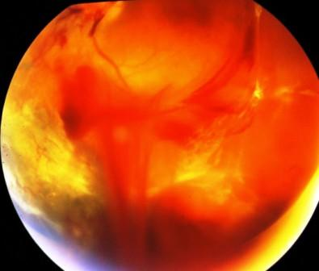
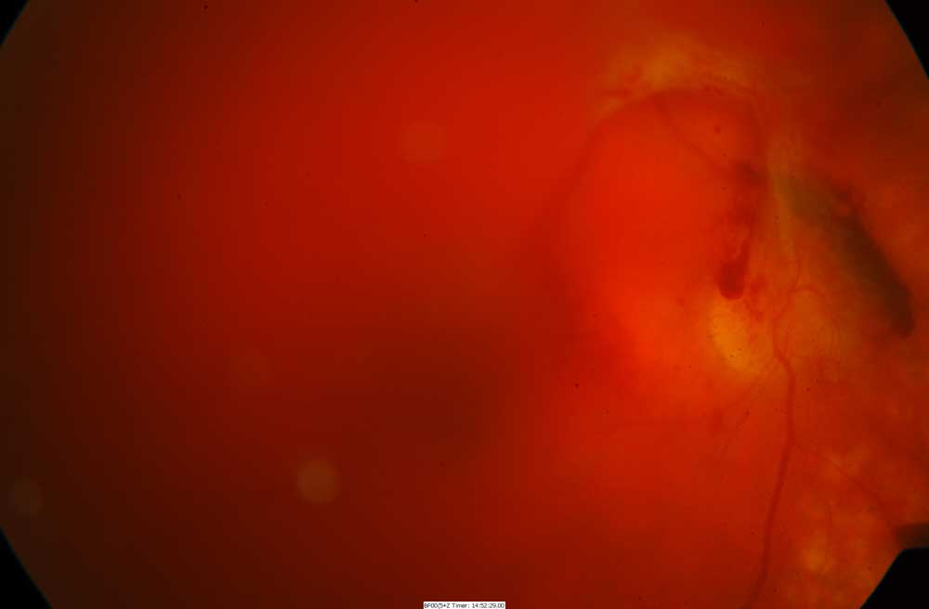
High risk PDR
NVD 1/4 – 1/3 disc area or
NVD and vitreous or preretinal Hg or
NVE ≥ 1/2 disc area and vitreous or preretinal Hg

Slide 37
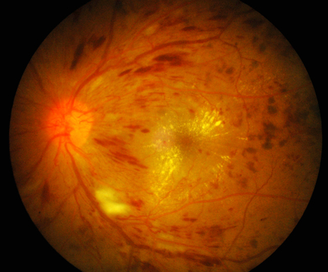
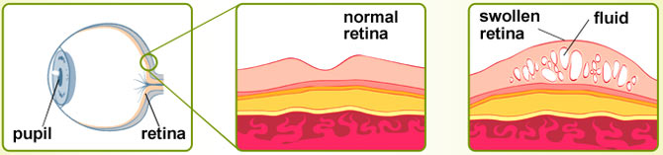
DME

Slide 38
EPIDEMIOLOGY
Incidence of DME over a 10-year
  20.1% among patients diagnosed before age 30 years (younger onset)
  39.3% among patients diagnosed after age 30 (older onset)
The frequency of DME increases with the duration and the severity of diabetes
Untreated CSME : 32% had 3 yr risk of MVL
Klein R, Klein BEK, Moss SE, Cruickshanks KJ. The Wisconsin epidemiologic study of diabetic retinopathy.
XV. The long term incidence of macular edema. Ophthalmology. 1995;102:7--16

Slide 39
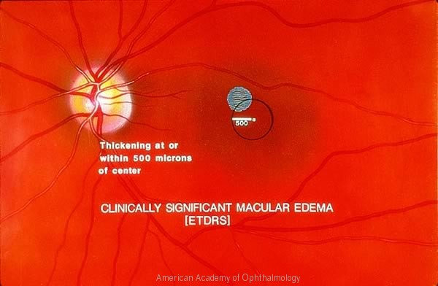
CSME(ETDRS) type 1

Slide 40
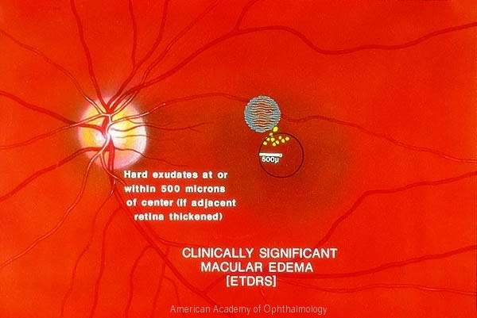
CSME(ETDRS) type 2

Slide 41
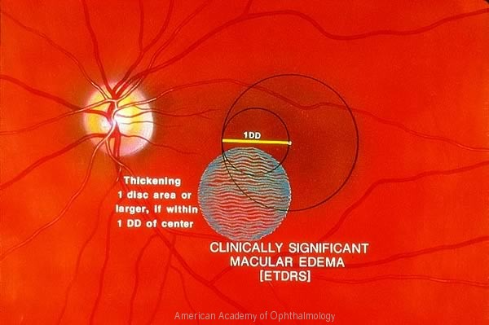
CSME(ETDRS) type 3

Slide 42
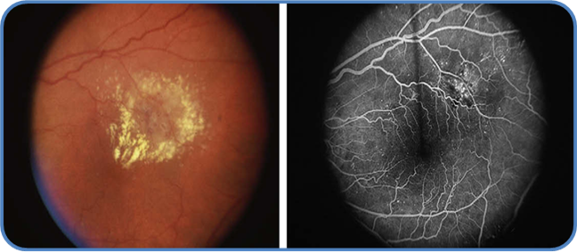
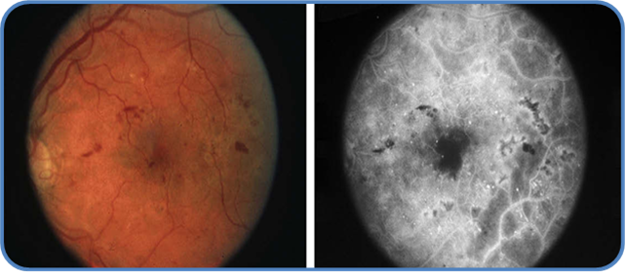
DME
Focal
Focal leakage of MA
Circinate rings of HE
Diffuse
Intraretinal leakage from a dilated retinal capillary bed
CME

Slide 43
Risk factor
Elevated DBP
Hyperlipidemia
Microalbuminuria
Nephropathy
Significant
Not significant
Recommend to control all
Aroca PR, Salvat M, Fernandez J, Mendez I. Risk factors for diffuse and focal macular edema. J Diabetes Complications. 2004;18(4):211—5
Miljanovic B, Glynn RJ, Nathan DM, et al. A prospectivestudy of serum lipids and risk of diabetic macular edema in type 1 diabetes. Diabetes. 2004;53(11):2883--92

Slide 44
Pathophysiology
Blood retinal barrier
Vasoactive factors (↑ advance glycation end products)
  ↑ VEGF-A (Muller cell) : ↑ Permeability
  ↑ Protein kinase C (β₂ isoform) : Vasoconstrict , ↑ Permeability
  ↑ Histamine : ↑ Permeability
  ↑ Angiotensin II (vitreous) : Vasoconstrict , ↑ VEGF
  ↑ Matrix metallproteinase : Remodeling ECM , ↑ Permeability
  ↑ Basic fibroblast growth factor (b-FGF) : Angiogenesis
  ↓ Pigment epithelial derived factor (PEDF) : Maintain BRB
  ↓ Platelet derived growth factor (PDGF) : Inh. angiogenesis
Vitreoretinal inferface
Notes:
Vitreoretinal interface :PVD,Posterior cortical vitreous, Thickening and taut post hyaloid,Macular traction,Role of ILM,Role of vitreous gel

Slide 45
Diagnosis with Imaging Modalities
Fluorescein angiogram
Optical coherence tomography
Retinal thickness analyser

Slide 46
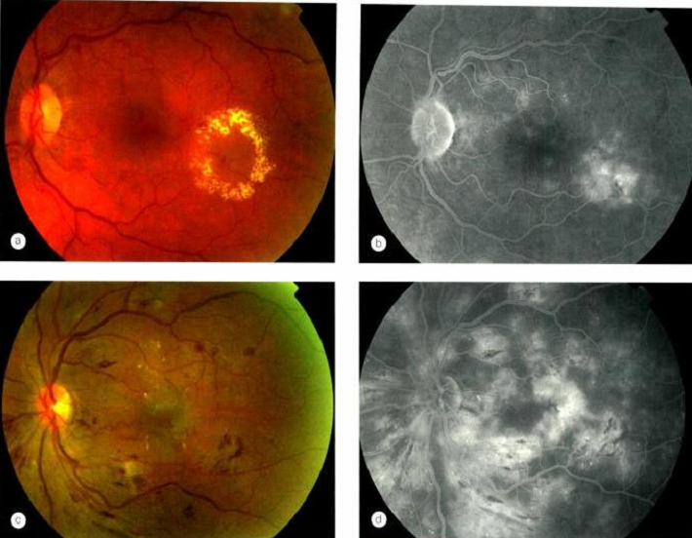
Focal
Diffuse

Slide 47
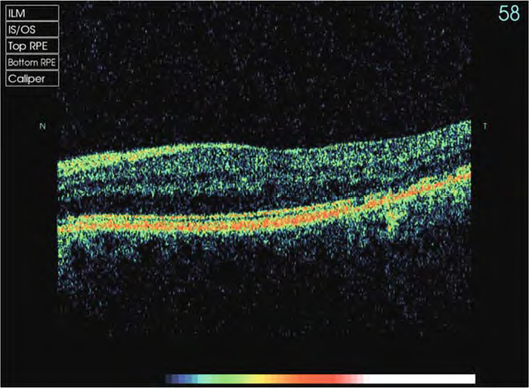
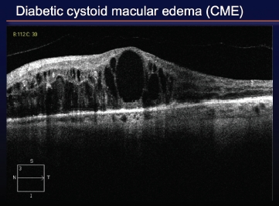
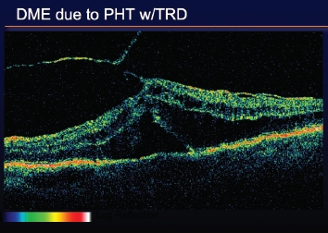
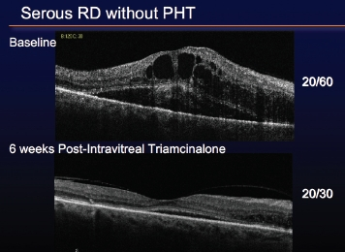
Optical coherence tomography
Diffuse , spongy
combine
Traction
combine

Slide 48
Optical coherence tomography
Advantages
  Non-invasive
  Quantitative information
  Type of DME
  Define treatment
  Baseline and Follow-up : significant change (+/- 10%)
  Prognosis : associate with integrity of
    IS-OS junction
    ELM

Slide 49

Causes of visual impairment in DM
Refractive error
  Corneal edema, lens edema
Macular edema
Vitreous hemorrhage
Retinal detachment
  TRD, combined RRD+TRD
Retinal ischemia

Slide 50
Treatment
Severity of background
CSME

Slide 51
Severity of background
DRS results:
  Laser photocoagulation reduces risk of severe visual loss compare to no treatment
  Treated eyes with high risk PDR achieved the greatest benefit
ETDRS results : PRP
  Small reduction in risk of severe visual loss
  Not indicated for mild to moderate DR
  May be most effective in patients with type 2 DM with severe NPDR to early PDR

Slide 52
How does LASER work
Ablating sick and hypoxic retina
Alteration of RPE-related mediators
  VEGF, PEDF, others
Increase outflow of fluorescein (possibly water)
Oxygen theory

Slide 53
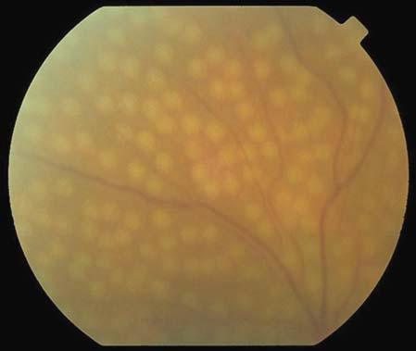

Slide 54
NEW VESSLE REGRESSION
Post treatment | Regression (%)
3 days | 20
2 wks | 50
3 wks | 72
6 mos | 63

Slide 55
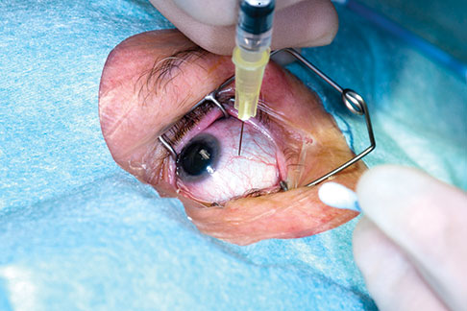
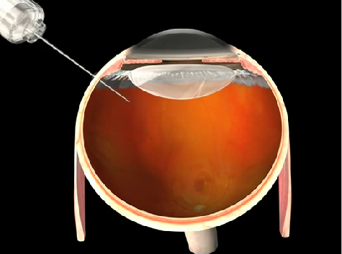
Pharmacological treatment
  Anti-inflammatory agent :
    Intravitreal Steroid Injection (TA, Dexa, Fluocinolone)
    Anti-VEGF Therapy (Pegaptanib, Ranibizumab, Bevacizumab, Aflibercept)
    IVT Eranercept, Infliximab
  Other Treatment Modalities : systemic
    ASA : no effect on DR, VH, VA but reduce CV morbidity (ETDRS)
    Hypoglycemic agent, hypolipidemic agent, anti-hypertensive agent

Slide 56
Trial
N (eyes)
Group
Prefer
Improve
DRCR.net
(2008)
840
Laser
IVTA 1 mg
IVTA 4 mg
Laser
5 letter
RISE/ RIDE
(monthly)
372/382
Sham
Lucentis 0.3 mg
Lucentis 0.5 mg
(RESOLVE : prn + rescue laser)
Lucentis
15 letter
ETDRS
Mild and moderate NPDR
  observe
Severe NPDR
Very severe NPDR
PDR
RESOLVE
(monthly*3)
151
10 letter
Inject – 9
RESTORE
345
Laser
Lucentis 0.5 mg
Lucentis 0.5 mg + laser
(monthly * 3 then prn)
Lucentis
Or
Combine lucentis
6 letter
Inject – 7
READ2
126
-
DRCR.net
(2010)
854
Laser
IVTA 4 mg + laser
Lucentis 0.5 mg + laser
(prompt , defer)
Lucentis
(IVTA : in pseudophakia same c lucentis)
9 letter
BOLT
80
Laser
Avastin 1.25 mg
Avastin
8 letter

Slide 57
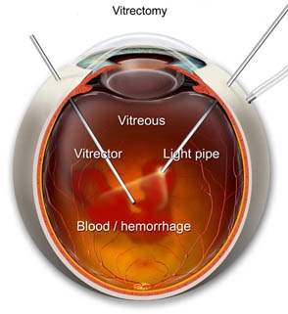
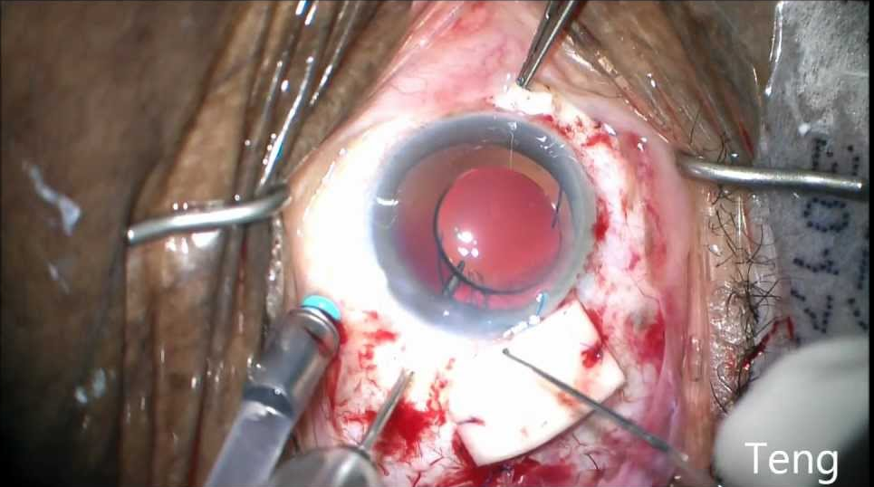
Vitrectomy in PDR
DRVS results : Early vitrectomy
  Benefit seen in type 1 DM of more than 20 year duration of DM
  Benefit seen only in eyes with most severe PDR

Slide 58
Systemic treament
Control BS, HbA1C
Control BP
Lipid profile

Slide 59
 | Rate of progression |  | Evaluation |  | Treatment
Level of DR | PDR 1 yr | HRC 5 yr | FFA | OCT | PRP | Macular laser | F/U(mo)
Mild NPDR | 5% | 15% | no | no | no | no | 12
ME |  |  | +/- | yes | no | no | 4-6
CSME |  |  | yes | yes | no | yes | 2-4
Mod NPDR | 12-27% | 33% | no | no | no | No | 6-8
ME |  |  | +/- | yes | no | No | 4-6
CSME |  |  | yes | yes | no | yes | 2-4
Severe NPDR | 52% | 60% | no | no | rarely | No | 3-4
ME |  |  | +/- | yes | Occasional after focal | occasional | 2-3
CSME |  |  | yes | yes | Occasional after focal | yes | 2-3

Slide 60
 | Rate of progression |  | Evaluation |  | Treatment
Level of DR | PDR 1 yr | HRC 5 yr | FFA | OCT | PRP | Macular laser | F/U(mo)
Very severe NPDR | 75% | 75% | no | no | occasional | no | 2-3
ME |  |  | +/- | yes | Occasional after focal | Occasional | 2-3
CSME |  |  | yes | yes | Occasional after focal | yes | 2-3
Non high risk PDR |  | 75% | no | no | occasional | No | 2-3
ME |  |  | +/- | yes | Occasional after focal | Occasional | 2-3
CSME |  |  | yes | yes | Occasional after focal | yes | 2-3
Non high risk PDR |  |  | no | no | yes | No | 2-3
ME |  |  | yes | yes | yes | usually | 1-2
CSME |  |  | yes | yes | yes | yes | 1-2

Slide 61
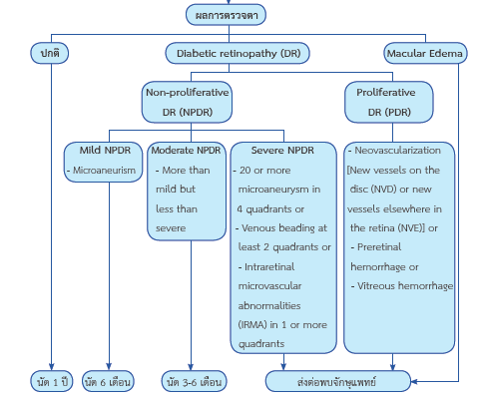

Slide 62
Screening
Type of DM | Recommendation time of 1st exam | Routine minimal F/U
Type 1 DM | 5 yr after onset or during puberty | Yearly
Type 2 DM | At time of diagnosis | Yearly
During pregnancy | Prior to pregnancy for counseling Early in 1st trimester Each trimester or more as indicated | 1-2 months post partum

Slide 63
Thank you

